Slide 1


Week 2: AI Core Operations
From Dockerization to Deployment
Mastering the SAP AI Core Runtime Engine

Slide 2



Week 2 Roadmap
Containerization
Orchestration
We start by packaging our models. You will learn to write Dockerfiles that encapsulate your code and dependencies, making them portable for SAP AI Core.
We move to defining workflows. You'll master Argo Workflows (YAML) to tell AI Core exactly how to run your training and inference jobs in the cloud.

Slide 3

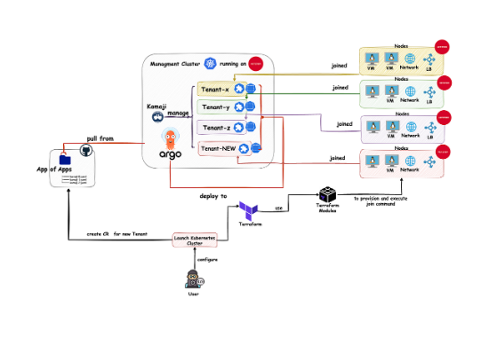
Day 6: The Argo Workflow Engine
Declarative AI Pipelines
SAP AI Core relies on Argo Workflows, a Kubernetes-native workflow engine. Instead of manually running scripts, we define our pipeline states in YAML.
•
Templates: Reusable blueprints for execution.
•
DAGs: Directed Acyclic Graphs defining step order.
•
Artifacts: Files passed between steps (e.g., datasets, models).

Slide 4
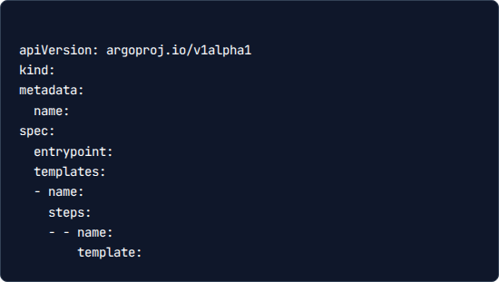
Day 6: Workflow Structure
Anatomy of a Template
# sample-workflow.yaml
A standard workflow configuration requires specific definitions. This structure allows AI Core to interpret your request.
WorkflowTemplate
Key Components:
training-pipeline
•
Executables: The Docker image to run.
my-pipeline
•
Inputs: Parameters or datasets.
my-pipeline
•
Outputs: Generated models or logs.
train-step
training-def

Slide 5

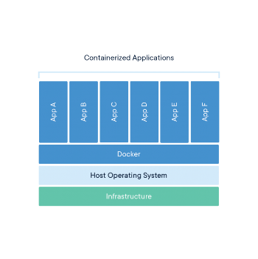
Day 7: Docker Strategy
Why Containerize?
SAP AI Core is a runtime environment, not a development environment. It doesn't know about your local Python installation.
By wrapping your Scikit-learn script in a Docker container, you guarantee that it runs exactly the same way in the cloud as it does on your laptop. This encapsulates all libraries (pandas, sklearn) and system dependencies.

Slide 6
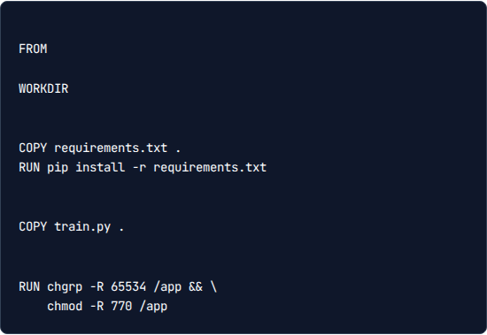
Day 7: The Dockerfile
Building the Image
# Dockerfile
The Dockerfile is your recipe. For the Free Tier course, we build locally and push to Docker Hub.
python:3.9-slim
/app
•
FROM: Start with a Python base image.
# Install dependencies
•
WORKDIR: Set the directory inside the container.
•
COPY: Move your local script into the container.
•
# Copy training script
RUN: Install requirements.
# Set permissions for AI Core

Slide 7
Day 8: GitOps & Synchronization
4. Sync
2. Push
AI Core pulls the latest commit and updates internal definitions.
Push your templates to the remote GitHub repository.
1. Commit
3. Register
Develop YAML templates locally and commit changes to git.
Define an "Application" in SAP AI Core pointing to your repo.

Slide 8









Day 9: Training Execution
Pending
Running
Completed
The job is queued. AI Core is requesting resources (CPUs/Memory) from the underlying Kubernetes cluster.
The Docker container is active. Your Python script is executing, processing data, and training the model.
Success. The process exit code was 0. The trained model file has been uploaded to the Object Store.

Slide 9

Day 9: Artifact Management
The Object Store
AI Core containers are ephemeral—they disappear after the job finishes. To save your model, your script must write to a specific output path.
SAP AI Core automatically captures files written to these Output Artifact paths and persists them in your connected Object Store (S3/Azure Blob), creating a permanent ID for the model.

Slide 10
Day 10: Deployment & Inference
Turning a static model file into a live API endpoint.

Slide 11
Day 10: Consuming the Endpoint
Component | Description | Example Value
URL | The deployment URL provided by AI Core | https://api.ai.prod.eu-central-1.../v2/inference
Header | Authentication Token | Authorization: Bearer
Header | Resource Group Target | AI-Resource-Group: default
Payload | The data for prediction (JSON) | { "text": "classify this ticket..." }

Slide 12
End of Week 2
You have successfully deployed a custom AI model on SAP BTP.
Next Week: Generative AI Hub & LLMs

Slide 13




Image Sources
https://miro.medium.com/v2/resize:fit:1200/1*Gq_obHF6_4ivavK6ENahGw.png
Source: itnext.io
https://www.docker.com/app/uploads/2021/11/container-what-is-container.png
Source: www.docker.com
https://static.thenounproject.com/png/5318508-200.png
Source: thenounproject.com
https://media.istockphoto.com/id/1169136078/vector/data-center-abstract-background-interior-of-server-room-digital-information-warehouse-web.jpg?s=612x612&w=0&k=20&c=1Bzl841OK5jvbmBXrSWf9NKcst6e7JeEAgBNtWU-4ws=
Source: www.istockphoto.com

